Slide 1

Rapid Scenario Generation for Multiple Simulations: An Application of the Military Scenario Definition Language (MSDL)
Curtis Blais, NPS MOVES Institute
Russell Dodds, Yumetech, Inc.
Jerry Pearman, Augustine Consulting, Inc.
MAJ Francisco Baez, TRAC-Monterey

Slide 2
Objectives and Background
Objectives:
  Develop capability to rapidly produce COA sketches
  Migrate COA sketch files to/from multiple simulations
  Investigate mechanisms for using MSDL as a scenario archival format
  Integrate automated DOE tools to rapidly build experiment files
Background:
  Generated by need for quick turn analysis
  Analysts require means to reuse validated scenario files
  Simulation tools do not generally provide DOE capability
  MSDL is available and becoming widely utilized
COA: Course of Action
DOE: Design of Experiments
MSDL: Military Scenario Definition Language

Slide 3
Rapid Scenario Generation (RSG)
Tool Overview
Enables rapid development of COA sketch (agents, sides, locations, objectives, routes, limited behaviors, buildings)
Utilizes common terms and symbols easily dragged/dropped onto play box
Facilitates re-use of validated scenarios and components
Enables migration of scenario data between simulations (Pythagoras, IWARS)
Utilizes MSDL for archival storage of multiple scenario data formats to facilitate data interchange
Simulation tool-specific data entry continues to be performed in the native simulation tool
IWARS: Infantry Warrior Simulation

Slide 4
DOE Tool Overview
Automates the process of developing an experimental design and generating experimental scenario files.
Supports construction of an NOLH design.
Facilitates execution of scenario files on a high performance computing cluster.
Provides a common interface for producing designs for multiple simulations that utilize an XML structure.
  Pythagoras
  IWARS
  MANA
  LBC
NOLH: Nearly Orthogonal Latin Hypercube MANA: Map Aware Non-uniform Automata
LBC: Logistics Battle Command XML: Extensible Markup Language

Slide 5
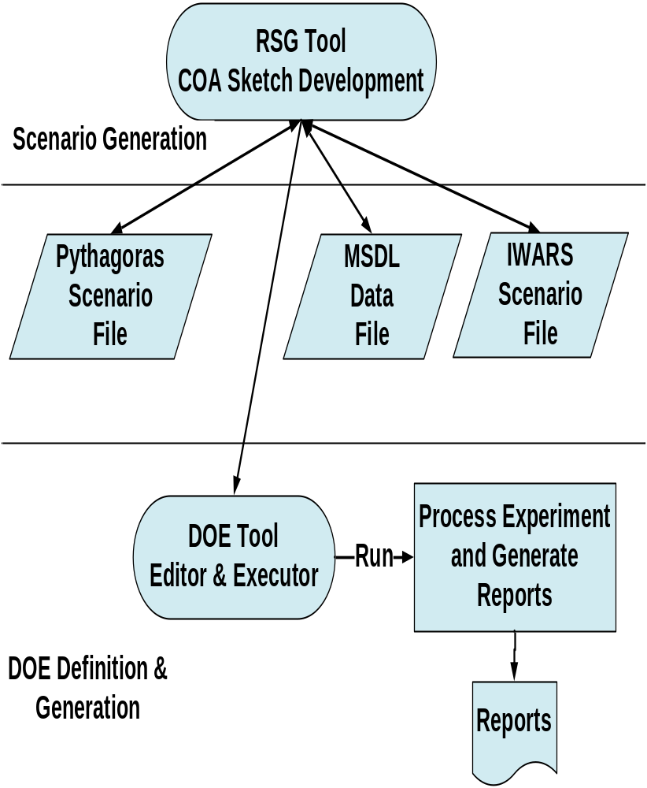
Scenario Generation & Execution Process
Develop COA sketch using RSG Tool
Save out to various formats for tool-specific editing and execution
  Agent/entity information (weapons, sensors, ranges, etc.)
  Execute scenario
Develop DOE, generate files, and execute design runs
  Launch DOE Tool Editor and import scenario.
  Select desired factors and factor levels to generate design.
  Launch DOE Tool Executor to generate scenario files.
  DOE Tool will save the scenario files for the sim-specific engine and launch the latest supported version (i.e., Pythagoras, IWARS).
Process experiment & generate reports
  Enables execution of experiment scenario files multiple times on a high performance computing environment
  Generates and aggregates results into a .csv file.
1
2
3
4

Slide 6
Example Work Flows
Open RSG, create a scenario, save out the scenario.
Open the file in an XML tool and note that it is an MSDL file.
Export the scenario to Pythagoras XML format.
Open the Pythagoras scenario file in Pythagoras and execute.
Open RSG, read an IWARS scenario file, make a change to the scenario, and save out to MSDL.
Read in the MSDL file, export the scenario to Pythagoras.
Open the Pythagoras scenario in Pythagoras and execute.
Open RSG, import a Pythagoras scenario file, and save out to MSDL.
Launch the DOE tool editor and develop an NOLH experimental design from the MSDL (extended) file.
Generate experimental scenario files based on the design.

Slide 7
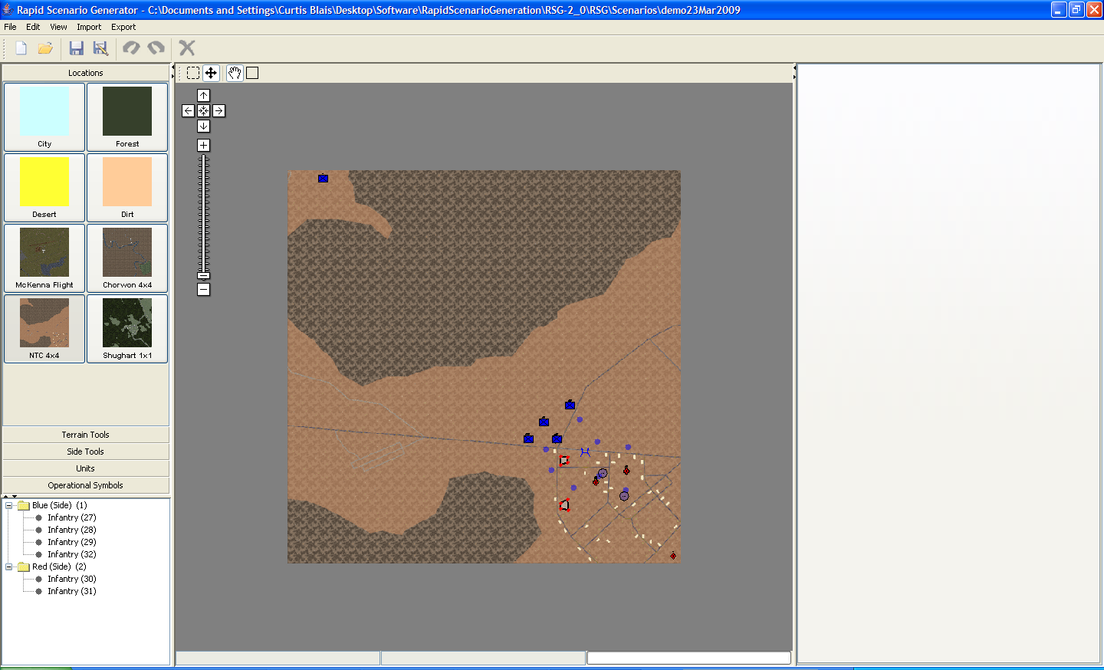
Scenario Developed in RSG

Slide 8
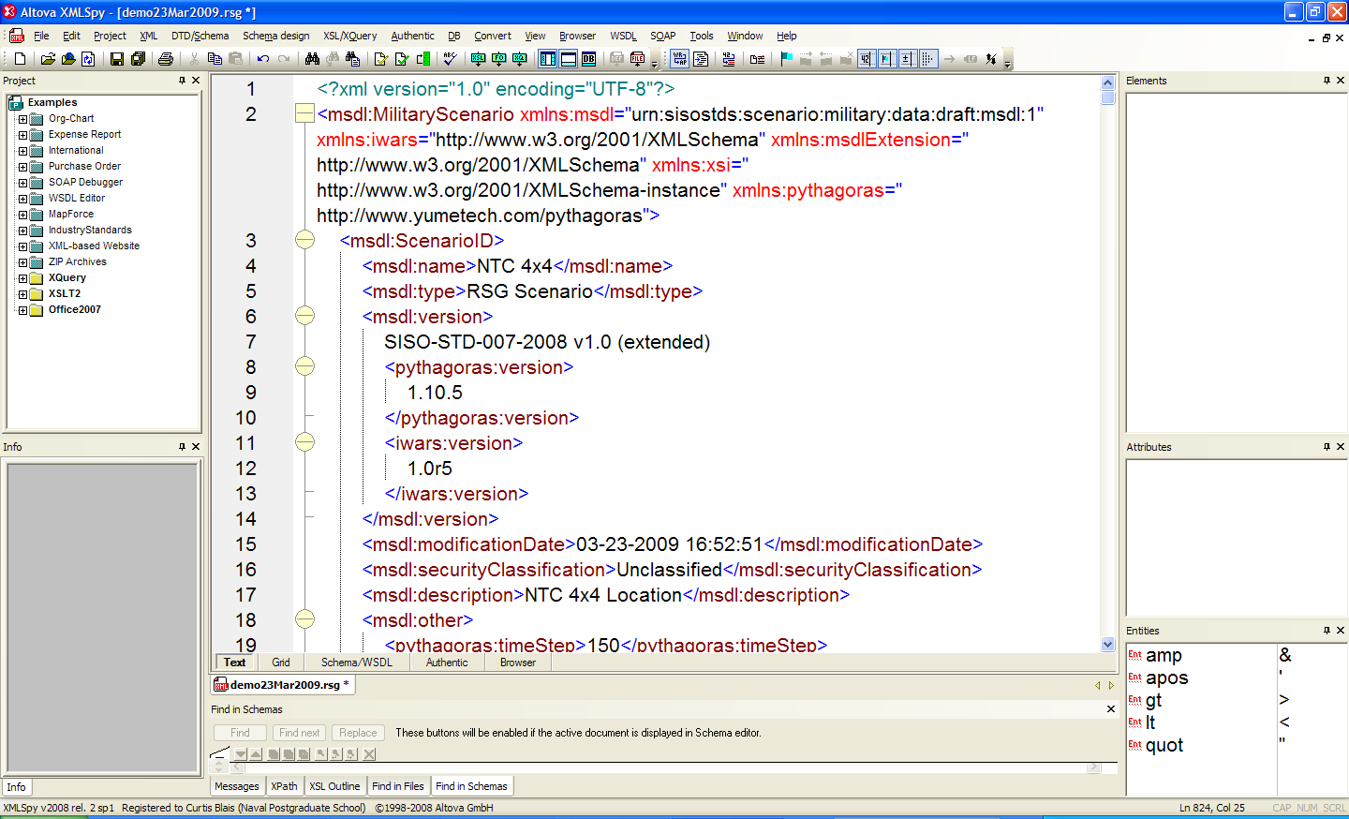
Scenario Saved to MSDL (extended)

Slide 9
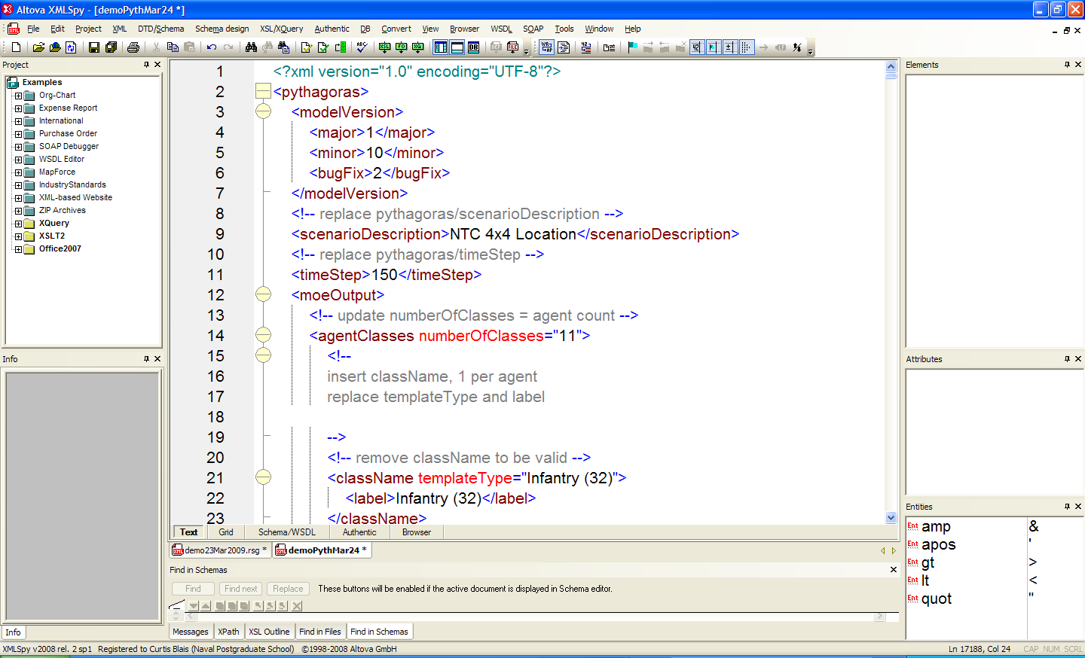
Export Scenario to Pythagoras XML

Slide 10
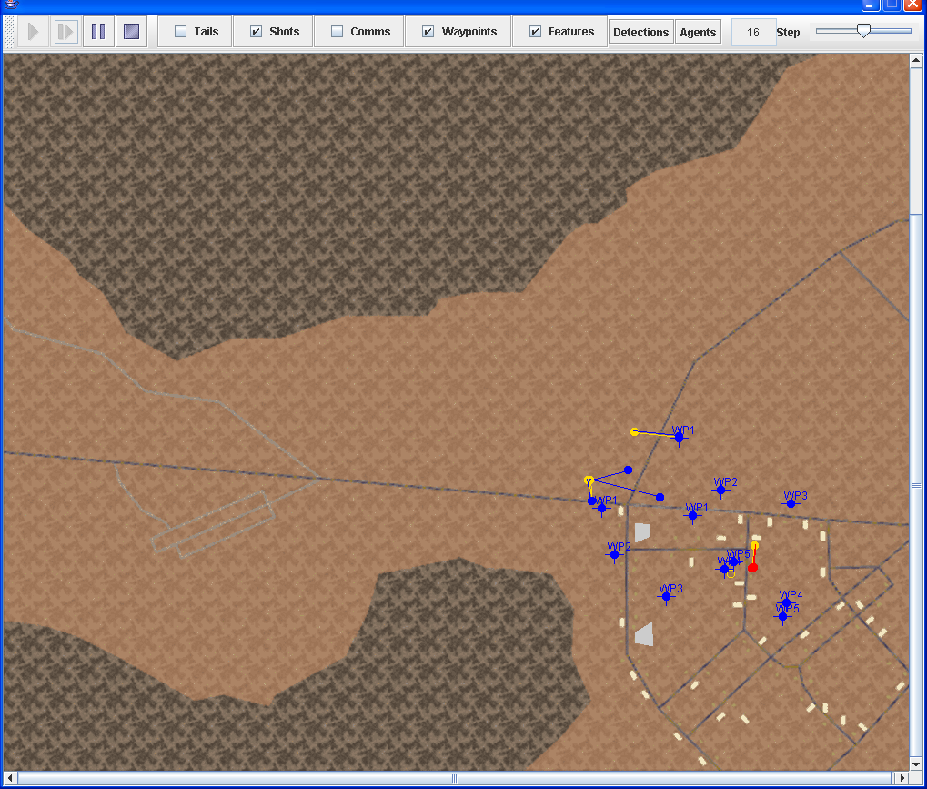
Execute Scenario in Pythagoras

Slide 11
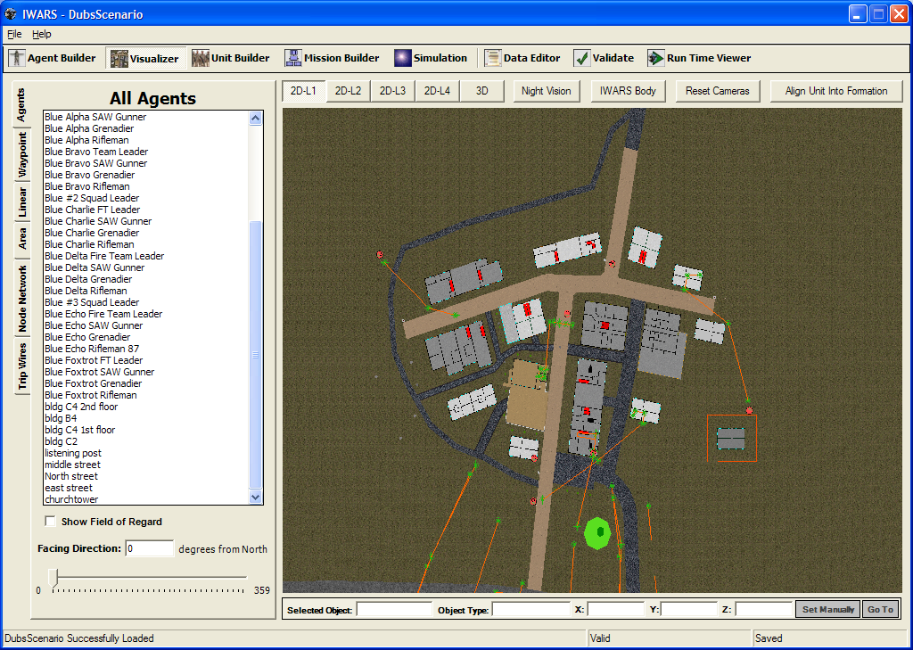
Construct an IWARS Scenario

Slide 12
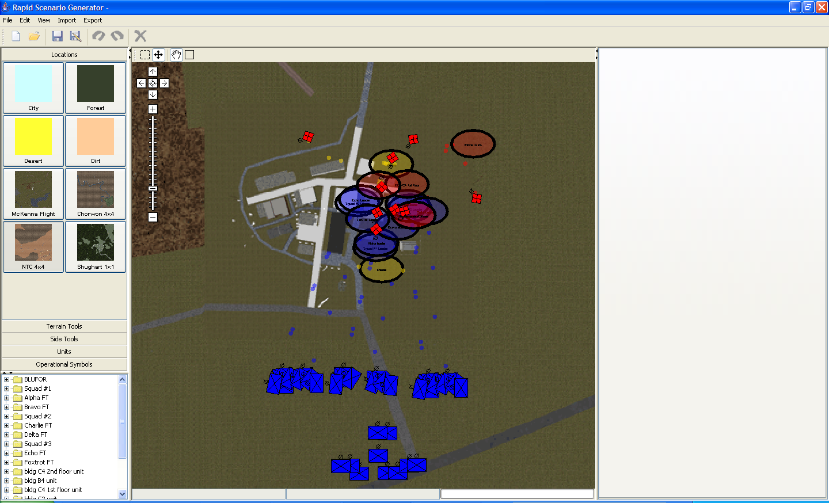
Import the IWARS Scenario in RSG

Slide 13
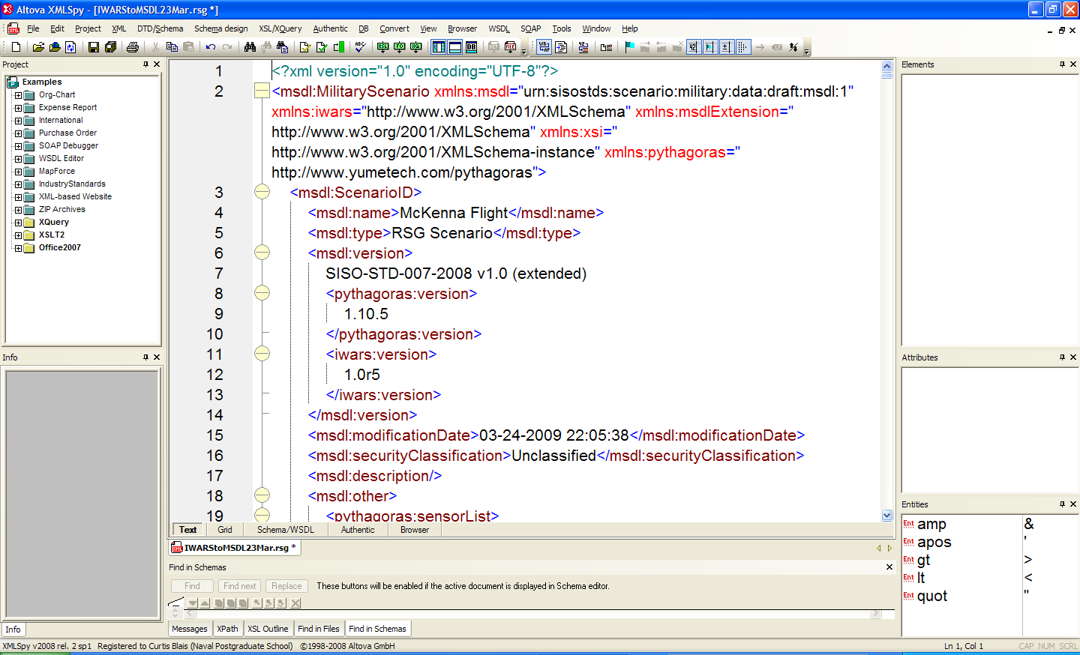
Save the Scenario to MSDL

Slide 14
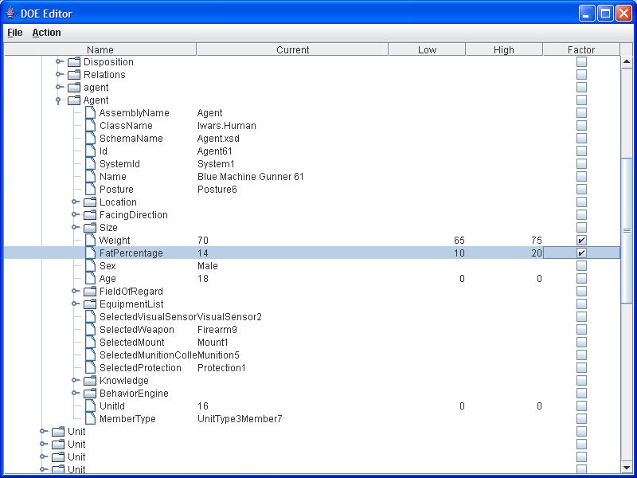
Open Scenario in DOE Tool for Experiment Design

Slide 15
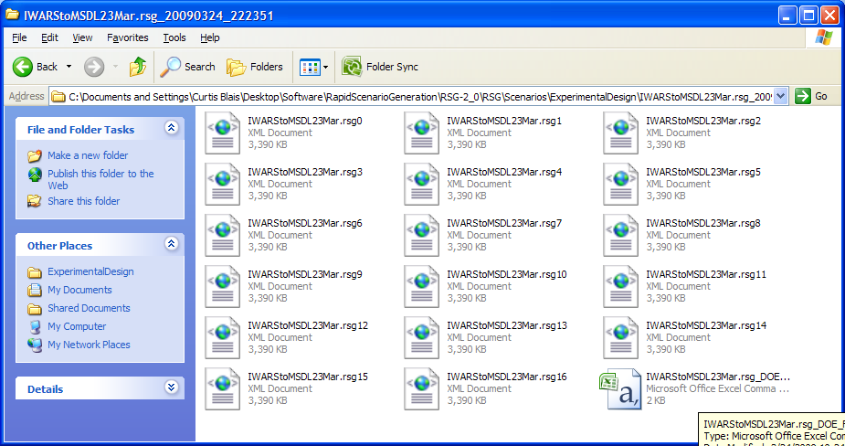
Generate Scenario Files for Experiment Execution

Slide 16
Mechanisms for Extending MSDL
Consider the MilitaryScenario/ScenarioID element (complex type modelIdentificationType from the http://www.sisostds.org/schemas/modelID namespace)
  It contains an XML “element wildcard”:
  <xs:any namespace="##other" minOccurs="0" maxOccurs="unbounded"/>
  Content from any namespace can be stored in this part of the MSDL scenario file
  Scenario file continues to be a “native” MSDL file
A new user-specific scenario XML schema can be created using defined types from the MSDL XML schema
  The MSDL schema is imported to enable validation of the reused structures
  Base types defined in the MSDL XML schema can be extended to add new content
  Base types defined in the MSDL XML schema can be restricted to remove unused content

Slide 17
Summary
MSDL provides a common structure for scenario data for diverse simulations
MSDL supports multiple use cases for data interchange
The MSDL XML schema permits inclusion of non-MSDL namespace data inside the MSDL XML structures
Investigations of MSDL capabilities can inform the M&S community for consideration of future enhancements to the standard and/or for establishment of best practices in the use of the standard

Slide 18
Questions?
For more information, contact:
Curtis Blais
MOVES Institute
Naval Postgraduate School
clblais@nps.edu

Slide 19
RSG Research Team
TRAC-Monterey (Study Lead)
  MAJ Francisco Baez, Team Lead transitioned from MAJ Jon Alt
  Mr. Jack Jackson, Senior Analyst
  Dr. Tom Anderson and MAJ Eric Tollefson, Supporting Analysts
NPS MOVES Department
  Mr. Curt Blais, Research Associate
NPS Operations Research Department
  Dr. Susan Sanchez, Co-director of SEED Center
Contractor Support.
  Mr. Russell Dodds, Lead Developer, Yumetech, Inc.
  Mr. Jerry Pearman, Senior Analyst, Augustine Consulting, Inc.

